Slide 1
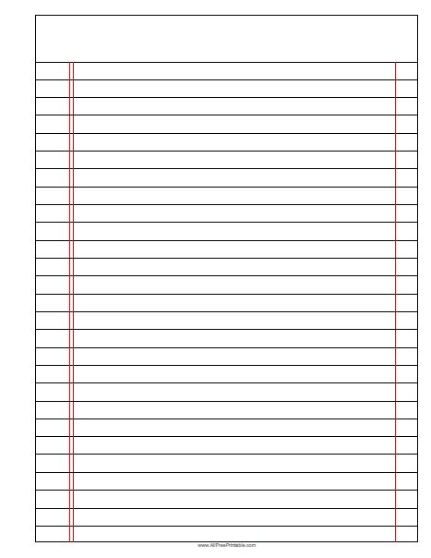






Global Warming
Read Now
Sunday 18 January 2026
Global Warming
Task:
Complete the Read Now by:
Stick in the sheet.
Using a highlighter as you read to identify key terms.
Answer the first four recall questions under the sheet in your book.
Answer the stretch question
Global Warming
Global Warming
Aim High | Work Together | Be Kind | Lead the Way

Slide 2
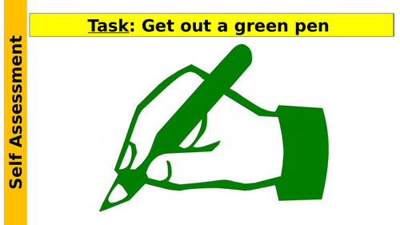
Read Now
Aim High | Work Together | Be Kind | Lead the Way
Aim High | Work Together | Be Kind | Lead the Way

Slide 3
Read Now
MARK SCHEME:
1. Global warming is the Earth's temperature rising.
2. A greenhouse gas is carbon dioxide.
3. Deforestation adds to global warming by removing trees that absorb carbon dioxide.
4. When the Earth gets too warm, ice melts and sea levels rise.
5. We need to reduce greenhouse gas emissions to protect our planet.
Aim High | Work Together | Be Kind | Lead the Way
Aim High | Work Together | Be Kind | Lead the Way

Slide 4
Daily Review
Follow your teachers instructions:
“When I say go show me a MWB and a MWB Pen”
You will have 10 seconds for each question.
Hold your MWB in the Ready position
“Show me”
You need to score 70% to pass
Subtitle ‘test score’ ?/10
Aim High | Work Together | Be Kind | Lead the Way
Notes:
Teachers remember to input the quiz score

Slide 5
Objectives
• Daily Review
• Follow your teachers instructions:
• “When I say go show me a MWB and a MWB Pen”
• You will have 10 seconds for each question.
• Hold your MWB in the Ready position
• “Show me”
• You need to score 70% to pass
• Subtitle ‘test score’ ?/10
• Aim High | Work Together | Be Kind | Lead the Way
Lesson 1
Lesson 2
Lesson 3
Lesson 4
Lesson 5
Lesson 6
Lesson 8
Lesson 9
Lesson 10
Lesson 7
Aim High | Work Together | Be Kind | Lead the Way
Notes:
11.2 5.19

Slide 6
Exposition
Aim High | Work Together | Be Kind | Lead the Way
Notes:
11.31 1.42
11.2 4.35

Slide 7
Exposition
Aim High | Work Together | Be Kind | Lead the Way
Notes:
11.31 1.42
11.2 4.35

Slide 8
Exposition
Aim High | Work Together | Be Kind | Lead the Way
Notes:
11.2 1.43
11.2 1.7

Slide 9
Deliberate Practice
Big Question:
Aim High | Work Together | Be Kind | Lead the Way

Slide 10

Deliberate Practice
Aim High | Work Together | Be Kind | Lead the Way

Slide 11
Exit Ticket
Which is the best definition of global warming?
A. Changing weather patterns
B. The Earth getting hotter
C. The increase in the overall temperature of the Earth’s atmosphere
2. Which is not a consequence of global warming?
A. Rising sea levels and flooding
B. Fossil fuels being burned
C. Extreme weather patterns
3. Which would be an action to reduce greenhouse gas emissions?
A. Cutting down trees
B. Using renewable energy sources
Aim High | Work Together | Be Kind | Lead the Way

